Slide 1
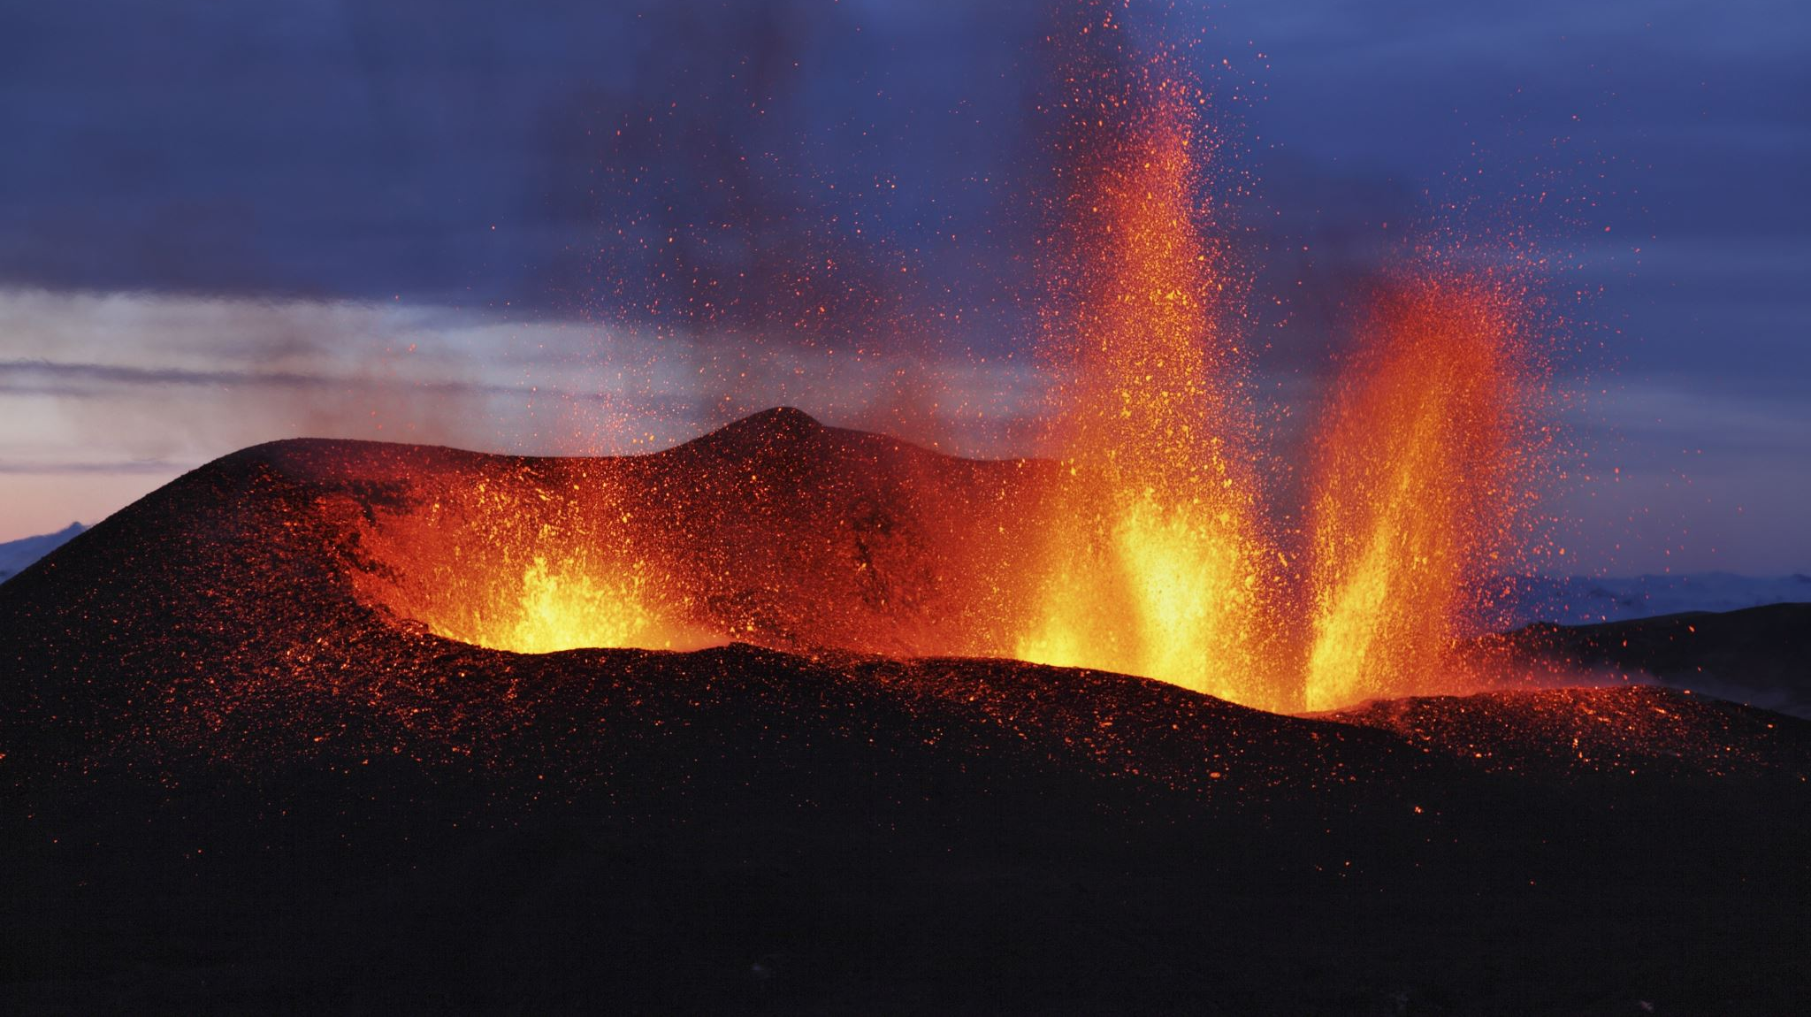
GDP hot take

Slide 2
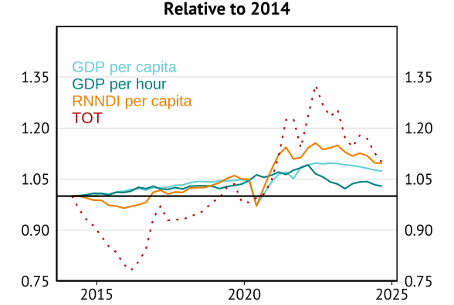
Income growth hasn’t been as bad

Slide 3
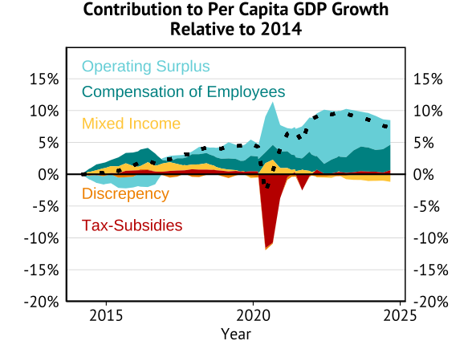
And it has still gone “normally” to workers

